Slide 1
Project HotSpot
Market analysis through automation & data science
Project 1 | Team 4
Alejandra
Ally
Ehab
Konrad
Notes:
Good evening everyone, my name is Alejandra and today along with my team members Ally and Ehab we are presenting for group number 4.
I want you to picture yourself with a hot business idea, You have the capital to cover start-up costs! You have the right team in mind that will help you set-up and operate the business. ...
How would you decide on the perfect location for your business? Would anybody like to share?
YES, GREAT!
This happens often, entrepreneurs have the right product, the right team but they can’t decide on a location.
On the other hand, you may be a business owner, growing at a fast pace ready to expand, the question then is,,, where should I expand to..
Welcome to project ‘HOT SPOT”

Slide 2

Project HotSpot’s Approach
We are the aggregator of many retail related market data and we translate them into valuable information & provide professional analysis.
We leverage various Python libraries to conduct in depth analysis and provide invaluable recommendations.
Notes:
We are aggregators of many retail related market data, and we translate that into valuable information and provide professional analysis.
We leverage various Python libraries to conduct in depth analysis and provide invaluable recommendations.
Lets go over an overview of the project:

Slide 3


Project Overview
Our Client PurpleSky - San Francisco’s most affordable medical and recreational cannabis dispensary. Located in the Mission district.
Since its opening in 2013, PurpleSky has been very profitable and is ready for expansion outside of California.
Our Task Our utility, "Project HotSpot", is tasked with providing market intelligence and recommendations for PurpleSky’s next retail location, preferably located on Seattle's Eastside.
Notes:
our client: Read slide /// Our Task:
Let's take a look at the project hot spot team, the ones that make this task possible.

Slide 4



Roles and Assignments
Ally
Lead, Project Management
Lead, Housing Data Engineering
Programming
Zillow Historical Housing Stats APIs and data
SFR YoY Projected Growth APIs and data
Ehab Lead, Program Logic and User Stories
Co-Lead, Design Engineering
Programming
Tesla Supercharger Station APIs and data
Zoning and Land Use Requirements
Alejandra
Lead, API Engineering
Co-Lead, Design Engineering
Programming
Yelp! APIs and data
Income Stat APIs and data
Konrad User Stories, GitHub Master
C0-Lead
Overall architect
Overall data & support
Notes:
Now that you know the team let's talk business:

Slide 5
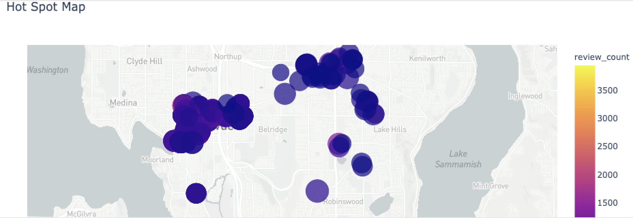
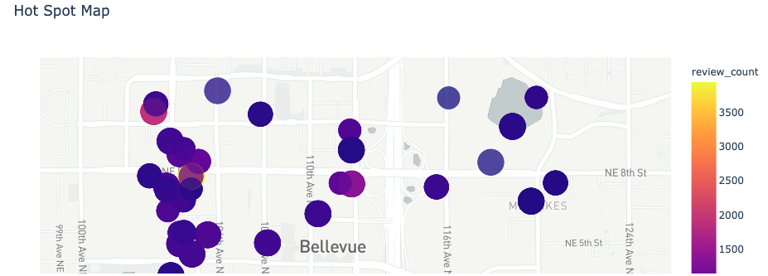
Let’s talk business
Market research can identify how customers and potential customers might view your business.
Our data scientist dig into millions of reviews, ratings, and pricing to find consumer trends of popular businesses.
Results are then provided to our user through an interactive map.
Business Ratings and Reviews per location.
Notes:
read points
Our user can type in a desired location, pinpoint an area of interest and take a closer look at nearby businesses. Their ratings and reviews per location helping the user understand the area.
Having good Market intelligence helps to minimize risk when making key business decisions.
But is also not all about location:
We also have to take into consideration, opportunity for revenue and pricing.

Slide 6
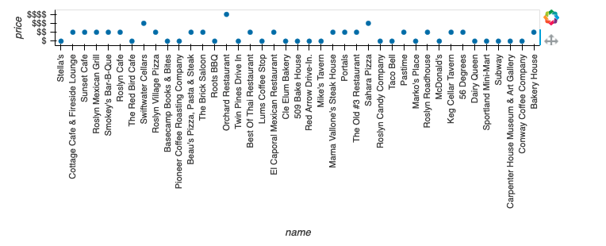
Money talks
Pricing is important since it defines the value that your product is worth for you to make and your customers to use.
Knowing the state of the local economy can inform your strategy to develop pricing to match your consumers price tolerance.
Notes:
I’ll pass it over to Ehab to go over the next set of data, Ehab take it over. Pricing is important since it defines the value that your product is worth for you to make and your customers to use.
Knowing the state of the local economy can inform your strategy to develop pricing to match your consumers price tolerance.

Slide 7

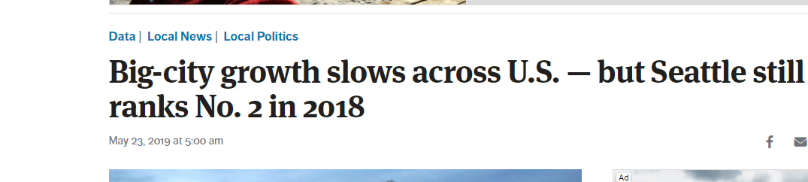
Economic Vibrancy
Are the areas I am looking at projected for growth?
Will they be viable markets in the future?
Notes:
Where is the next Silicon Valley?

Slide 8
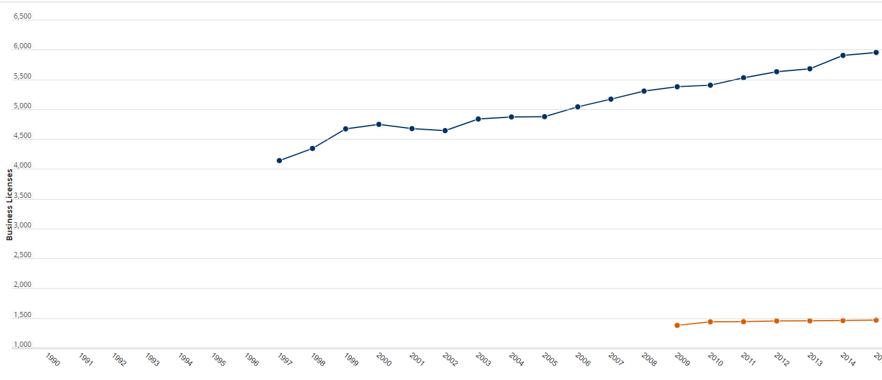
Redmond Business Licenses
Source: City Permit data filtered for commercial
Notes:
Permit data, Permit issue, value

Slide 9
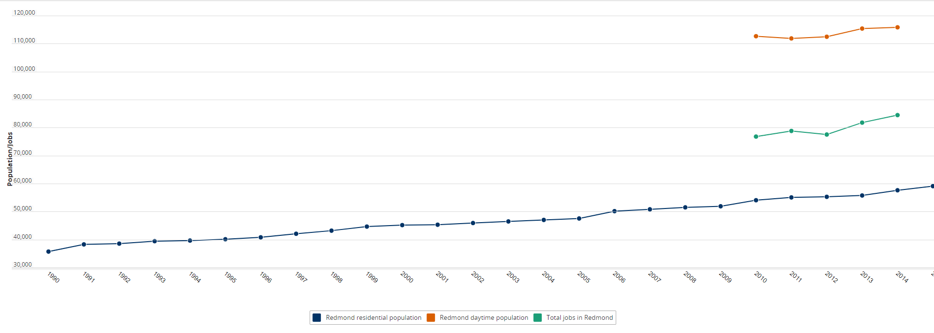
Redmond population growth
Source: City demographics dataset-filtered for population
Foot traffic filtered by day time

Slide 10

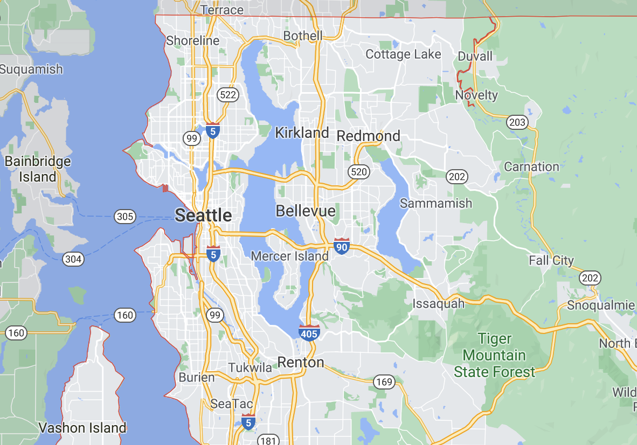

Single Family House Sales & Growth Trend
Ally
Bellevue, Redmond and Kirkland are the main customer base for PurpleSky.
Data was downloaded from Zillow: - 10 years monthly average sales - YoY forecast
Challenge: Zillow data is in a different orientation (i.e. index in rows instead of columns). We had to transpose it to continue analysis in Panda.

Slide 11
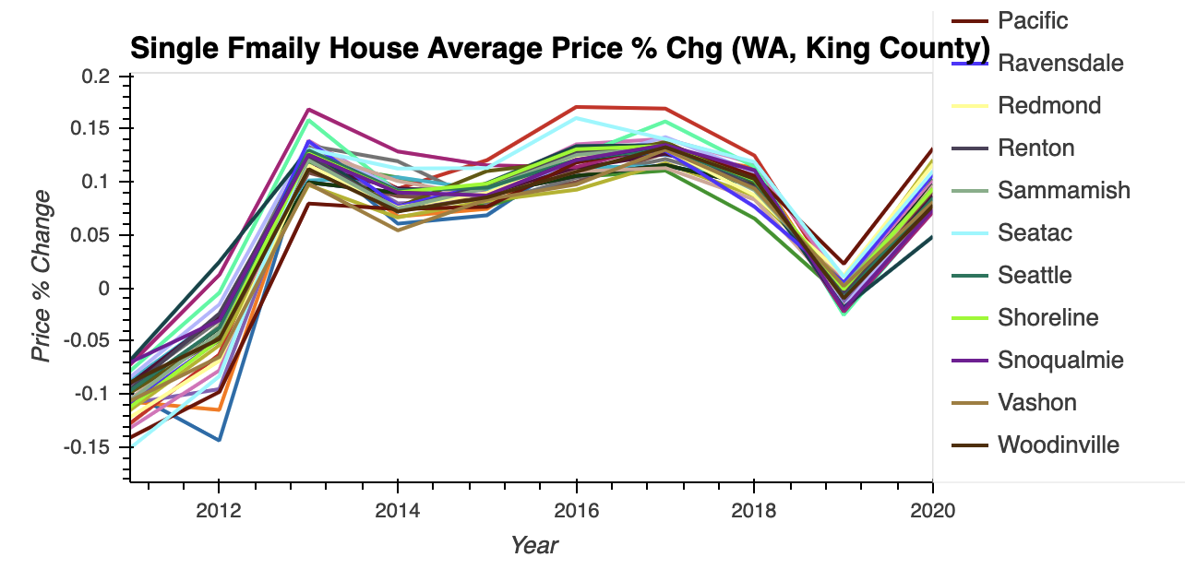

Single Family House Sales & Growth Trend
Ally
Overall single family houses in King County have steady increases at an average of 5% YoY over the last 10 years.
Upward growth

Slide 12
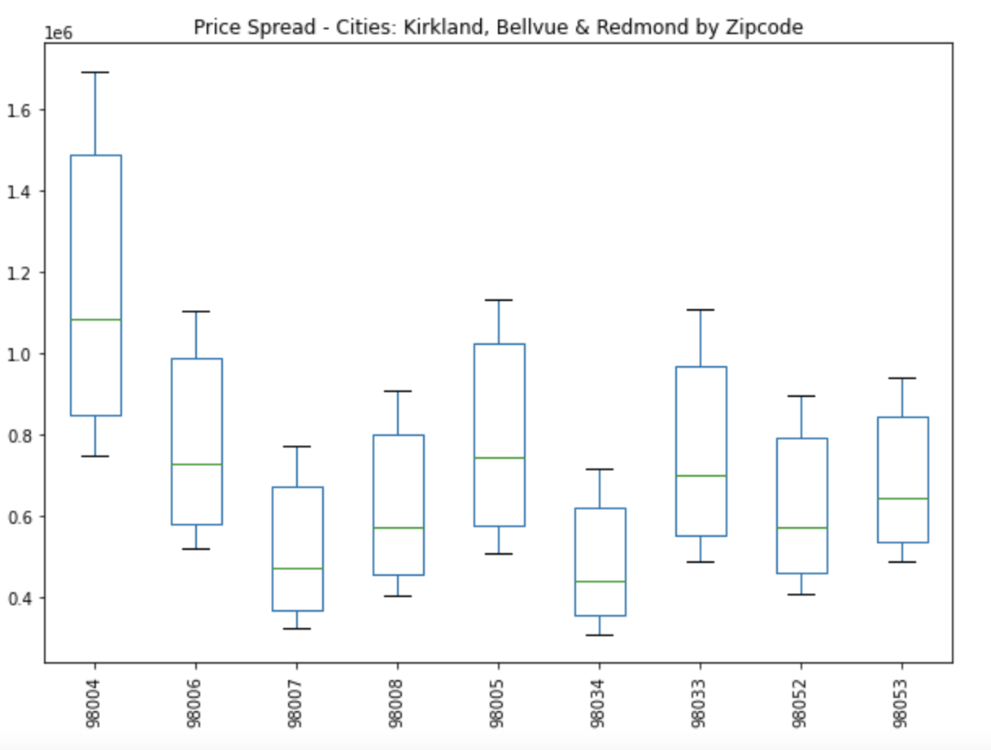
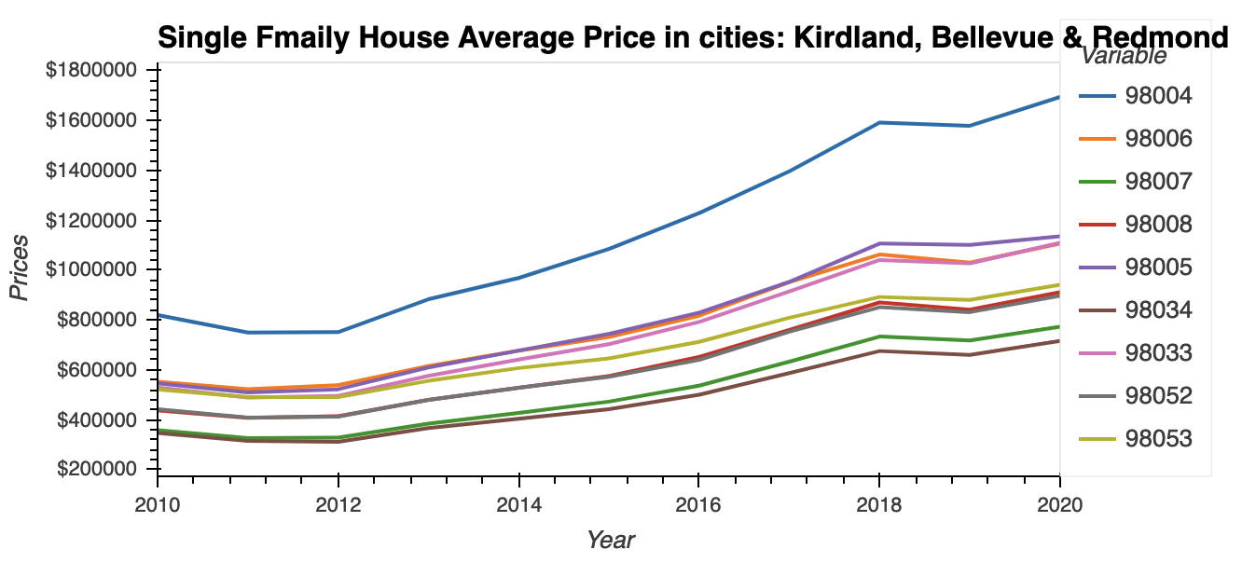

Single Family House Sales & Growth Trend
Ally
Among the zip codes in Kirkland, Bellevue & Redmond, Bellevue has the highest price growth and most volatilities.

Slide 13
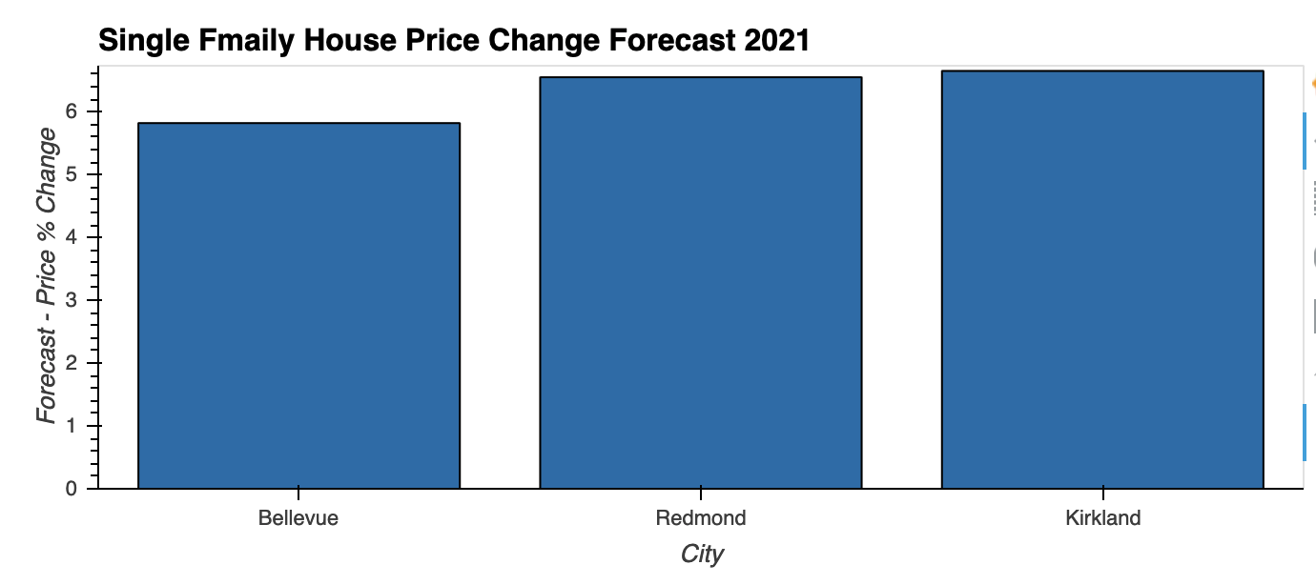
Growth Trend in Bellevue, Redmond & Kirkland
Ally
Average sales price in 2020:
Bellevue: $1, 12 mil
Redmond: $900k
Kirkland: $915k
Redmond & Kirkland - stead YoY growth at 6.5%
Bellevue - slightly slower YoY growth at 5.8%
Provided Bellevue has already experienced a pricing spike in the past years, we believe the slightly slower growth compare to its neighbor areas is expected.
Notes:
Bellevue, Redmond & Kirkland’s housing prices remains relatively high and sustains a solid growth. We expect these areas to continue attract high-end middle income families & professional to the neighborhood.

Slide 14
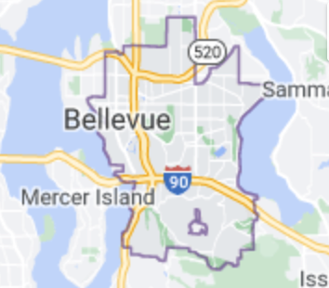
Overall Recommendation
Keypoint #1
Bellevue is the city in Seattle we would recommend for PurpleSky to open up its first store outside California.
Keypoint #2
Sustainable housing market ensures stable customer base.
Booming retail business with high volume of foot traffic, demand & accessibility.
Keypoint #3
Regional growth points to Bellevue as one of the transit center with proximity to local business and commercial activities.

Slide 15
Project HotSpot - Future Milestones
February 2022
August 2021
October 2021
May 2022
Establish more API connections to varieties of market data supported by Python for analysis.
Deliver comprehensive recommendation & reports per client requests.
2021 |  |  |  | 2022
User interface ready for clients to input key parameters.
Soft launch & enable subscription services.
*sample datasets are: demographic, competing facilities, geo-spatial relationships, bike paths, and more...

Slide 16

Project Takeaways…
Challenges we faced:
API access restrictions:
Requires paid subscriptions
Lots of open government data sites
Integrating GIS data
Data cleaning & formatting
Data in csv files have different orientation
Different data types in source file cause issues during data summarization
Notes:
Engineer a bot that just runs the (Yelp!/Supercharger/Building_Permit/Zillow/County_Records/CRE Listings/Craigslist/defaults_df).ipynb in perpetuity, searching every single market (domestic and foreign) for those with the bare minimum amount of data needed to return opportunities with pre-defined parameters, running an internal due_diligence.ipynb utility, and sending reports on the best ones to Ehab and presenting only the info that’s important to him and recommendations for immediate next steps. Just riffing here, -k.
Develop An Index that accounts for...

Slide 17
Beyond the MVP
If we had more time for the project, we would like to:
Build command line interface (CLI), illustrate user input of parameters.
Import all datasets into database, link tables, conduct all analysis using SQL queries.
Develop comprehensive and presentable market analysis reports to illustrate our recommendation.
Add cannabis competitor data in the neighborhood we recommended.
Create an custom index based on our data collected to track the overall retail locations supply and demand
Notes:
Engineer a bot that just runs the (Yelp!/Supercharger/Building_Permit/Zillow/County_Records/CRE Listings/Craigslist/defaults_df).ipynb in perpetuity, searching every single market (domestic and foreign) for those with the bare minimum amount of data needed to return opportunities with pre-defined parameters, running an internal due_diligence.ipynb utility, and sending reports on the best ones to Ehab and presenting only the info that’s important to him and recommendations for immediate next steps. Just riffing here, -k.
Develop An Index that accounts for...

Slide 18
We hope you enjoyed our presentation :-)
Q & A

